Slide 1
EEEE2076 – Software Project
Qt, VTK, Group Work
Paul Evans

Slide 2
GUIs and Qt

Slide 3
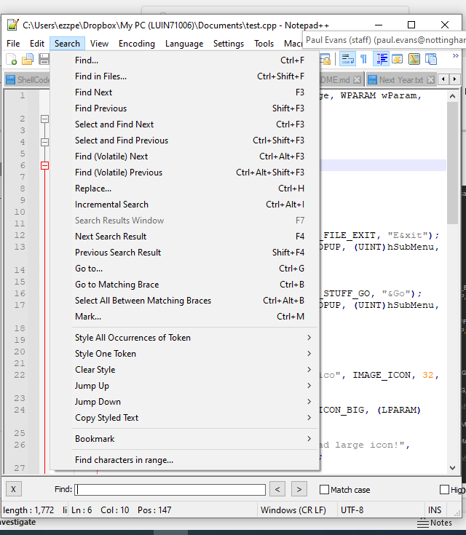
Graphical User Interfaces (GUIs)
LRESULT CALLBACK WndProc(HWND hwnd, UINT Message, WPARAM wParam, LPARAM lParam) { switch(Message) { case WM_CREATE: { HMENU hMenu, hSubMenu; hMenu = CreateMenu(); hSubMenu = CreatePopupMenu(); AppendMenu(hSubMenu, MF_STRING, ID_FILE_EXIT, "E&xit"); AppendMenu(hMenu, MF_STRING | MF_POPUP, (UINT)hSubMenu, "&File"); hSubMenu = CreatePopupMenu(); AppendMenu(hSubMenu, MF_STRING, ID_STUFF_GO, "&Go"); AppendMenu(hMenu, MF_STRING | MF_POPUP, (UINT)hSubMenu, "&Stuff"); SetMenu(hwnd, hMenu); hIcon = LoadImage(NULL, "menu_two.ico", IMAGE_ICON, 32, 32, LR_LOADFROMFILE); if(hIcon) SendMessage(hwnd, WM_SETICON, ICON_BIG, (LPARAM)hIcon); else MessageBox(hwnd, "Could not load large icon!", "Error", MB_OK | MB_ICONERROR); hIconSm = LoadImage(NULL, "menu_two.ico", IMAGE_ICON, 16, 16, LR_LOADFROMFILE); if(hIconSm) SendMessage(hwnd, WM_SETICON, ICON_SMALL, (LPARAM)hIconSm); else MessageBox(hwnd, "Could not load small icon!", "Error", MB_OK | MB_ICONERROR); } break;
Familiar windows, toolbars, menus dialogs, etc on modern OS
These are drawn by the operating system / window manager
You call functions to determine what is drawn
Mechanisms to have mouse clicks etc passed to your program
OS determines which Window these happen in and directs appropriately
Core/Native Windows API (Win32 API) is C based and hasn’t changed much since the 80’s
Not user friendly, requires a lot of code to achieve basic results
Code that uses it will require complete rewrite for other OS
User32.dll contains the Windows API functions
Microsoft has added layers on top
MFC – C++ layer
.NET Much higher level, but will still interface to Win32 API on Windows Machines
Win32 / MFC – Windows only. .NET has some cross platform capabilities
Other libraries exist that are truly cross-platform, e.g. Qt
Easier / faster to use
Same code works across many different OS
Example Win32 API Code (http://www.winprog.org/tutorial/)
Notes:
https://github.com/microsoft/Windows-classic-samples/tree/main/Samples/Win7Samples/begin/LearnWin32/BaseWindow/cpp

Slide 4
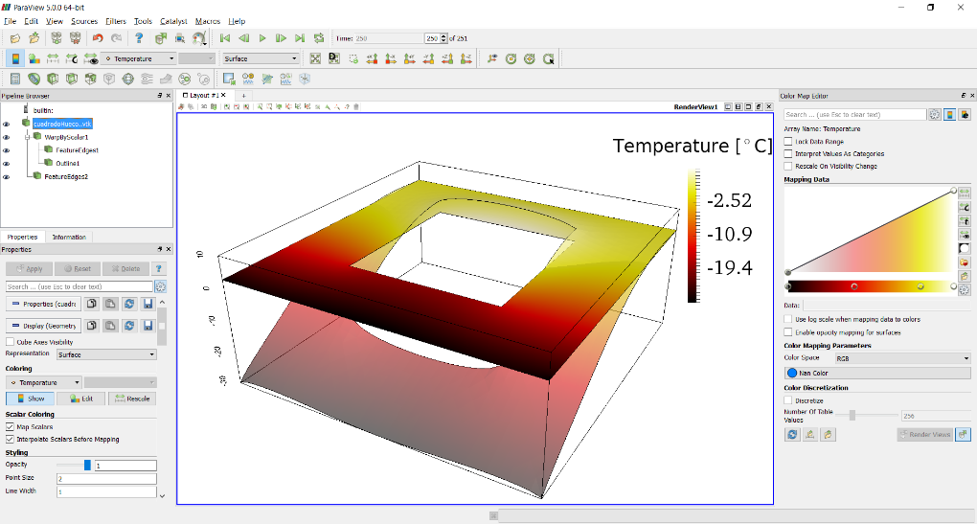
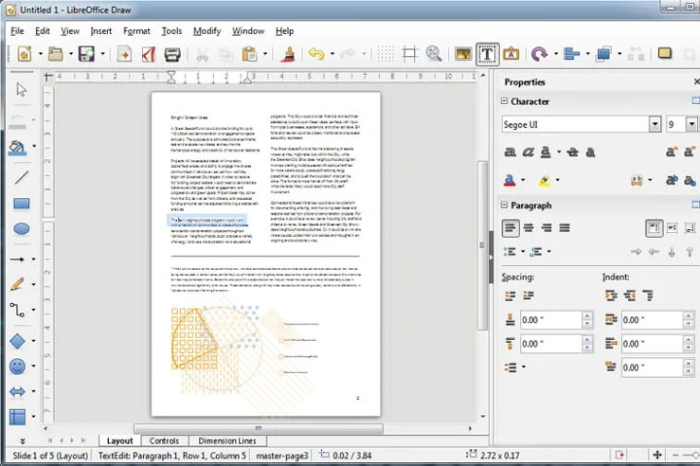


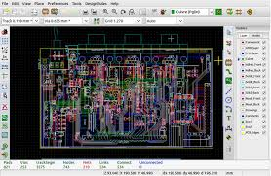

Cross Platform GUI Libraries
Allow Windows, menus, etc to be created like Win32
Are not specific to one OS
Same code compiles on many OS – type of abstraction layer
Library handles translation to the native API of the target OS, e.g Win32
Usually designed to be easy to use
Draw the GUI
Template code created automatically
Fill in the gaps to get the behaviour you want
Qt one of the most common
Used by AutoDesk, Adobe
Others include GTK (Firefox, LibreOffice), WxWidgets (Code::Blocks, KiCAD)
We use Qt because:
Ease of use
VTK designed to interface to Qt
C++ based

Slide 5

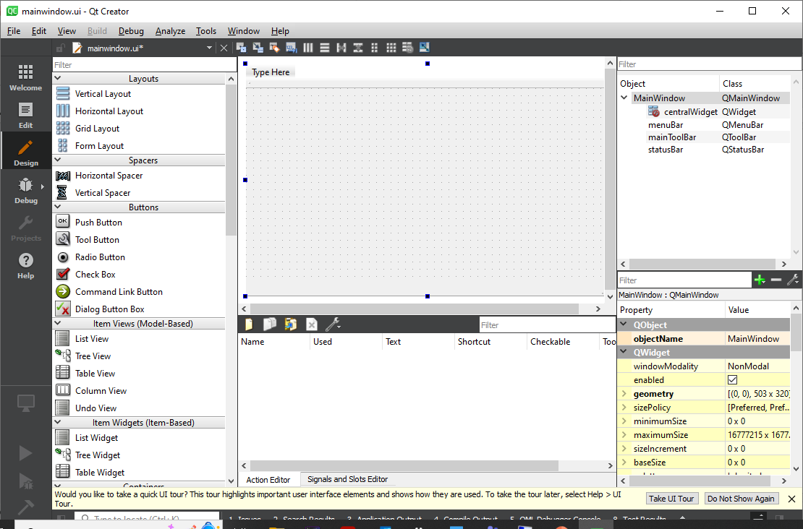
Creating a user interface
MainWindow.ui
MainWindow.cpp
Main.cpp
MainWindow.h
Qt Creator Application
Create GUI, save, it will create templates
These are added to your CMake Project – Qt can also create the CMakeLists.txt for you
CMakeLists.txt

Slide 6
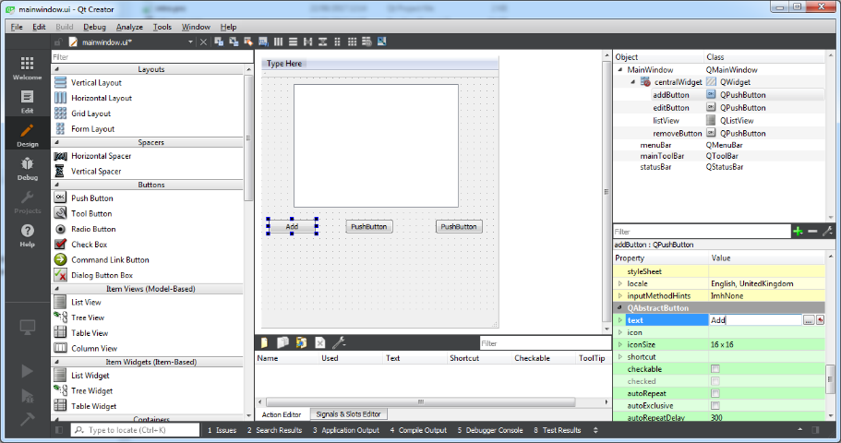

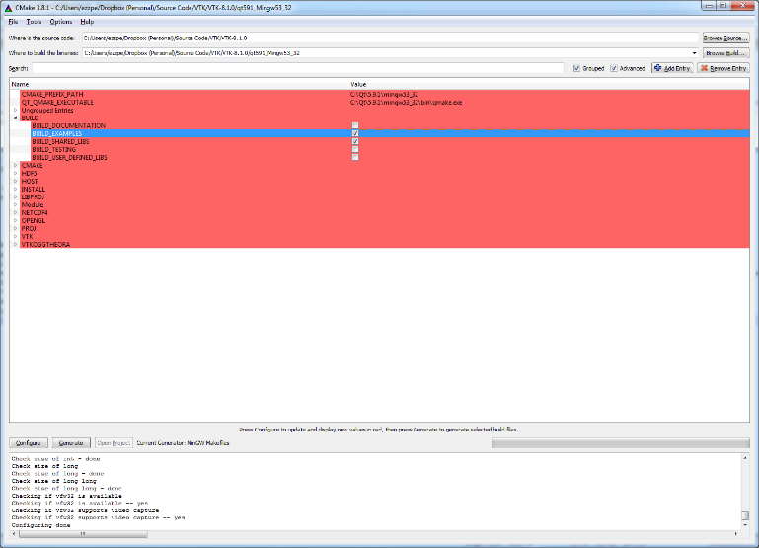

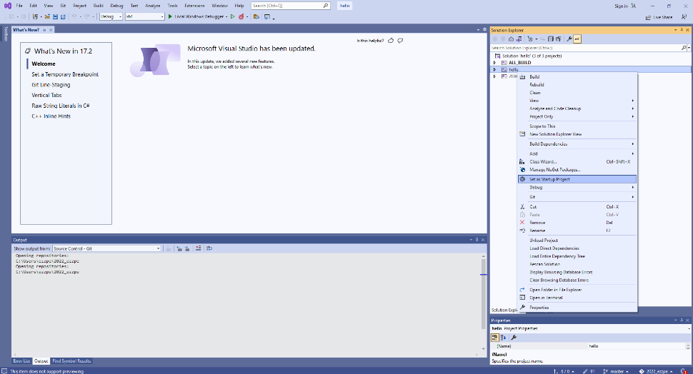

Using Qt - Process
Create project in Qt Creator
This generates source files
Main.cpp
MainWindow.cpp
MainWindow.h
MainWindow.ui
Draw application in Qt Creator and save
Create a CMakeLists for your application
Need to add all of files above
+ some specific lines to include Qt library
Create a Visual Studio project using Cmake
Use Visual Studio to edit code, return to Qt creator to add to / edit user interface
This is the suggested process as VS better for code editing/debugging
You can edit UI and code using Qt creator if you choose
There is a more advanced version of Qt creator for other types of application (Qt Designer / Qt Design Studio) – don’t use this.

Slide 7
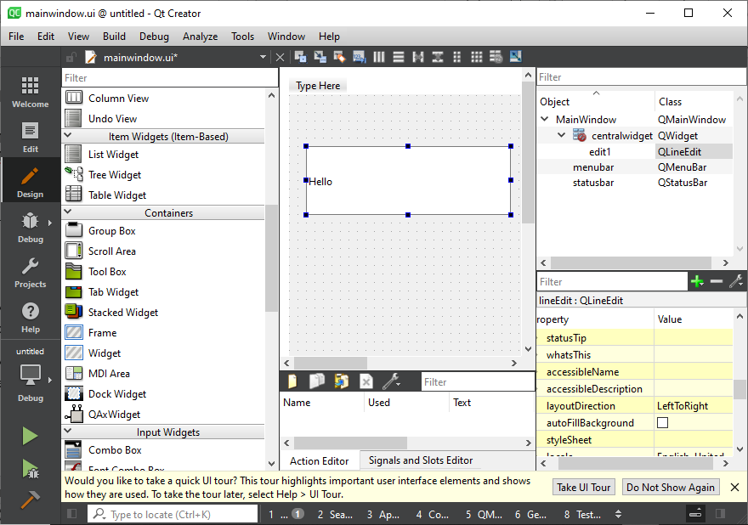
MainWindow.cpp – define application behaviour
/* MainWindow.h */ class MainWindow : public QMainWindow { Q_OBJECT private: Ui::MainWindow *ui; public: explicit MainWindow(QWidget *parent = 0); ~MainWindow(); public slots: void resetView( ); };
MainWindow.cpp contains C++ class for MainWindow
Constructor called when window created
You add other functions
The “ui” class
A ui class is created by Qt in MainWindow
It contains classes for each UI object added in Qt Creator
You add a QLineEdit called “edit1”, ui contains a class called edit1
You can call the member functions of edit1
E.g. to put some text into it, or retrieve text from it.
Common mistake:
The class name in ui (edit one in this case, i.e. ui->edit1) corresponds to the name you give the class in QtCreator
If you call it Edit1, edit2, etc – the code also needs to change!
QString text = ui->edit1->text();
ui->edit1->insert( “A new string” );

Slide 8
Signals and Slots
/* MainWindow.h */ class MainWindow : public QMainWindow { Q_OBJECT private: Ui::MainWindow *ui; public: explicit MainWindow(QWidget *parent = 0); ~MainWindow(); public slots: void resetView( ); };
Qt classes can emit signals
These are triggered when certain things happen, e.g. a button is clocked
Qt classes can contain special functions called slots
These can be linked to signals so that they execute when the signal is triggered
To capture user actions
Create a slot function
Connect it to the relevant signal, of the relevant class
Two ways to connect
Use the connect() function in a constructor
Use the signal editor in Qt Creator
/* Added to MainWindow constructor */ connect( ui->resetViewButton, &QPushButton::clicked, this, &MainWindow::resetView );

Slide 9
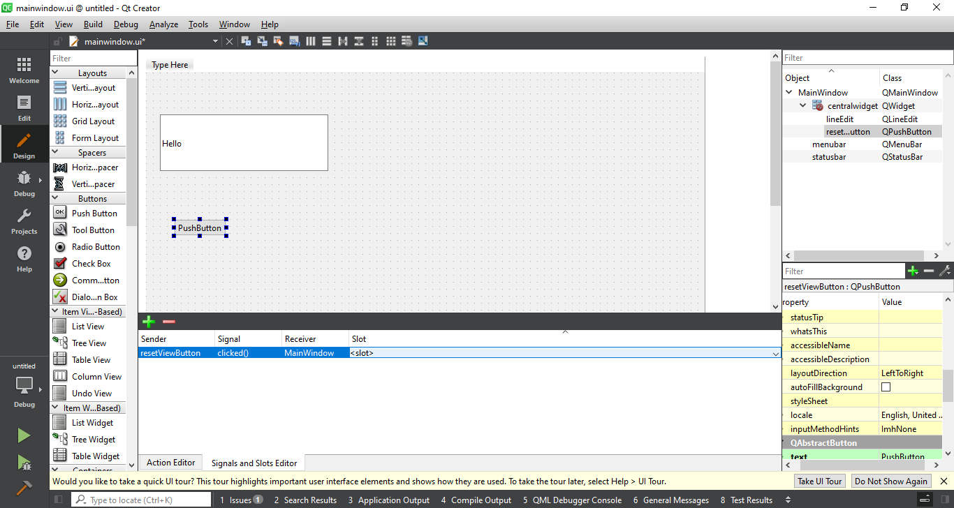

Slide 10
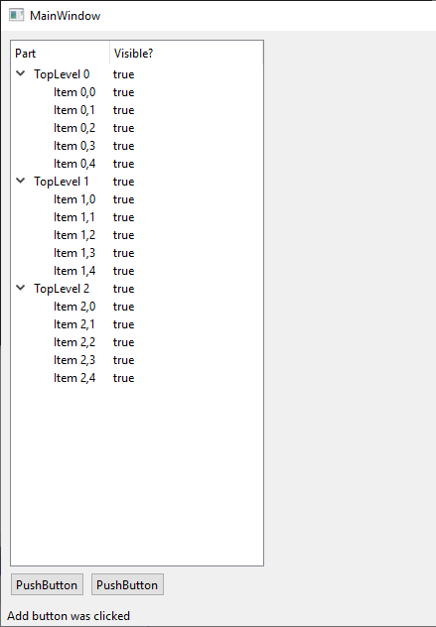
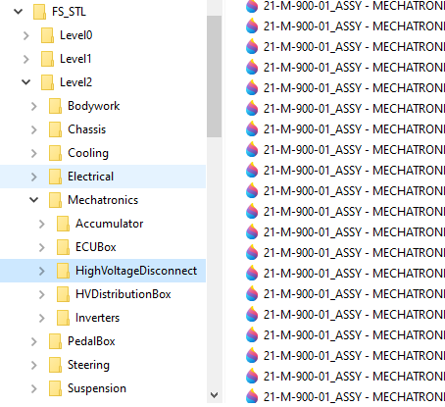
TreeViews
You need to create a TreeView to visualise and store the CAD model components
Requires creation of two classes
ModelPartList
This extends the QAbstractItemModel class
Standard class that represents the tree structure
ModelPart
This represents a node in the tree
Each node is an instance of this custom class
The class is designed to store a CAD model part
Qt ListModel classes and functions can then be used to determine which part is selected, to add new parts at a point in the tree, etc
Templates are provided, don’t try to copy the code from the worksheet, it is available on Github:
https://github.com/plevans/EEEE2076/tree/master/individual/Worksheet6/TreeModel

Slide 11
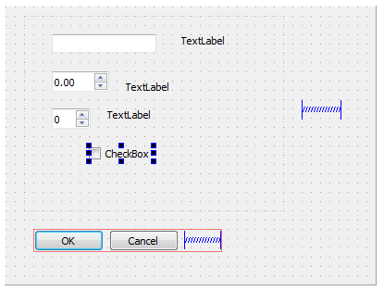
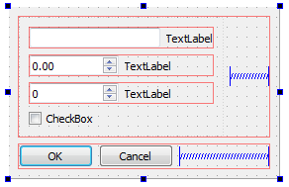
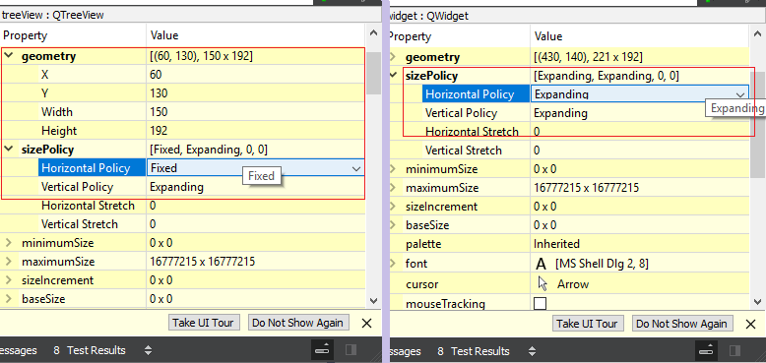
Other points
Dialogs (e.g. a popup option menu) – have their own window, also have their own ui class which is accessible within that class
E.g. in the dialog constructor, the ui variable contains the UI components of the dialog and not those of MainWindow
Layouts
Getting the Windows to behave nicely as they are resized isn’t easy.
Layouts are used to do this, in summary:
Items are snapped into groups called layouts.
The top level layout scales with the window
Each UI item (widget) has a size policy
Fixed size, try to take up as much space as possible, be as small as possible etc
Spacers can be added to take up slack if items do not stretch
Getting this right usually requires quite a bit of trial and error!

Slide 12
3D Rendering and VTK

Slide 13

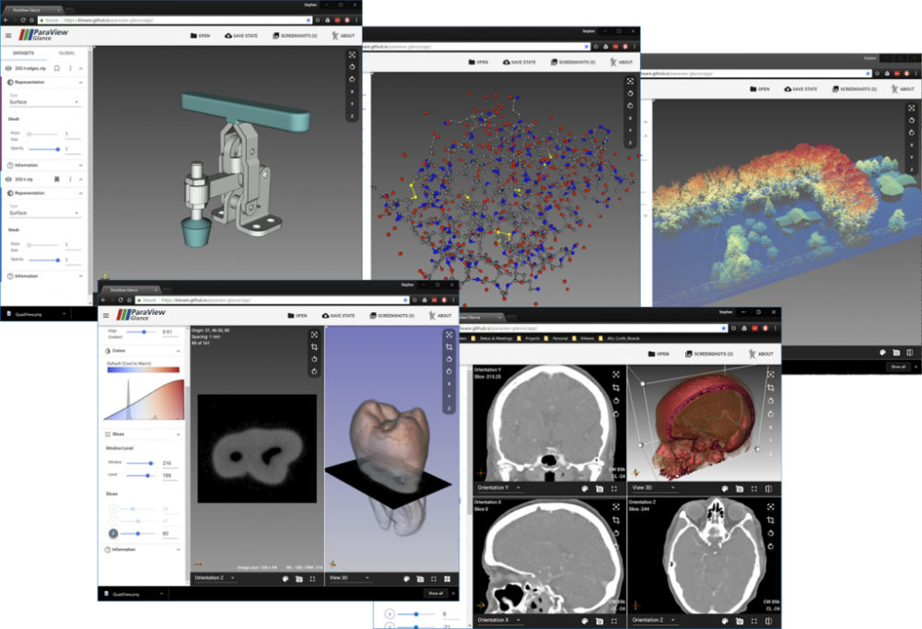
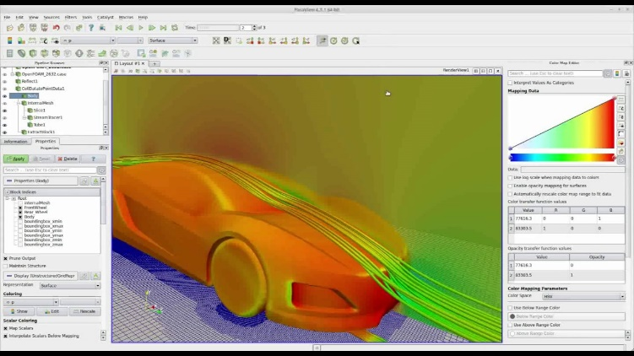
3D Rendering and VTK
Visualisation Tool Kit
Library designed for Paraview software
VTK: Abstract / High Level Library
“I want to render this STL model file and colour it red”
VTK deals with the specific system (e.g. through low level library OpenGL) to make this happen for you
To render a model using OpenGL – you’d have to:
Define the shape in terms of vertices and polygons
Define the colour of each polygons
Any “special effects” etc, mean recalculating things in terms of polygons
With any modern version of OpenGL you also have to write “shader” code for the graphics card
Doing anything complicated (i.e. something that looks good) is incredibly difficult/time consuming
VTK can be embedded in a Qt GUI
VTK is another C++ library
https://www.paraview.org/

Slide 14
Compiling VTK
You need to have a version of the VTK library that is:
Compatible with your compiler, e.g. Visual Studio 2022, 64-bit
Compatible with your version of Qt, e.g. Qt 6.4
Compatible with any other options you need, e.g. OpenVR
All of these things are configured when VTK is compiled
This means there are an almost unlimited number of different versions of VTK
They cannot all be offered for direct download!
You must compile VTK yourself with the options you require
This can be time consuming and is easy to get wrong!
Make sure you follow the instructions

Slide 15
3D Rendering and VTK
Data Source
vtkSTLReader
Renderer
vtkRenderer
vtkOpenVRRender
Renderer manages the scene:
Actors
Lights
Etc
Mapper
vtkDataSetMapper
vtkPolyDataMapper
Actor
vtkActor
RenderWindow
vtkGenericOpenGLRenderWindow
vtkOpenVRRenderWindow
Mapper translates data into renderable format
Actor positions object in scene and sets properties such as colour
RenderWindow is link to hardware
Generic render window can be linked to widget in Qt
Open VR render window links to VR hardware
vtk application is a chain of linked classes – the vtk pipeline

Slide 16
3D Rendering and VTK
Filters can be inserted into pipeline to modify appearance
Data Source
vtkSTLReader
Filters
vtkShrinkFilter
vtkClipFilter
Renderer
vtkRenderer
vtkOpenVRRender
Mapper
vtkDataSetMapper
vtkPolyDataMapper
Actor
vtkActor
RenderWindow
vtkGenericOpenGLRenderWindow
vtkOpenVRRenderWindow

Slide 17
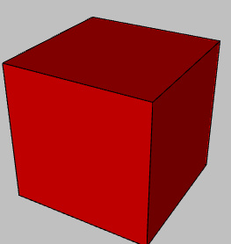
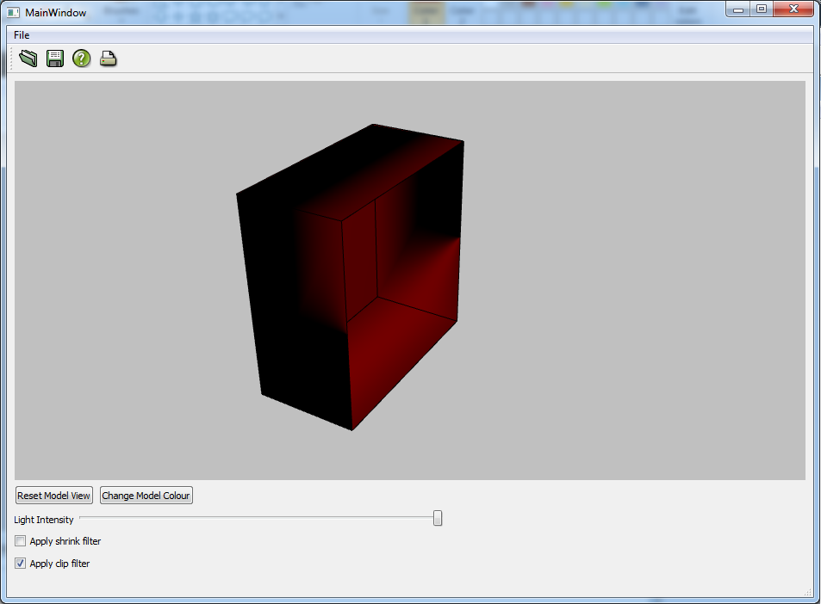
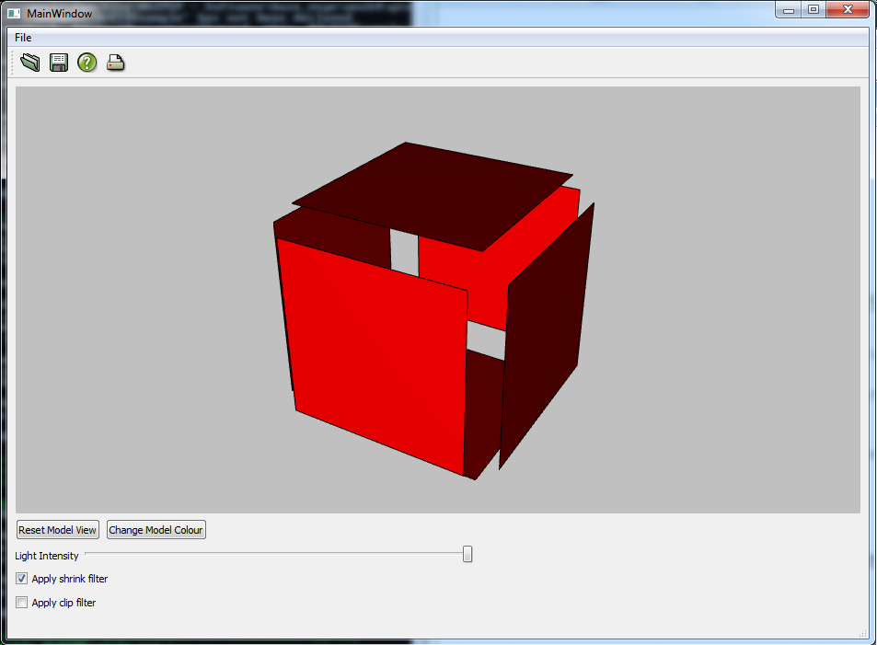
3D Rendering and VTK
Cube
Cube with clip filter
Cube with shrink filter

Slide 18
Multiple Items in same 3D rendering
Data Source
Mapper
Filters
Actor
Data Source
Mapper
Filters
Actor
Renderer
RenderWindow
Data Source
Mapper
Filters
Actor
Data Source
Mapper
Filters
Actor
Each data source (CAD file) has its own mapper, filters and actor.
These are all added to the same renderer
Mapper & filters are responsible for creating geometry to rendered
Actor determines how this is rendered (position, colour, etc)

Slide 19
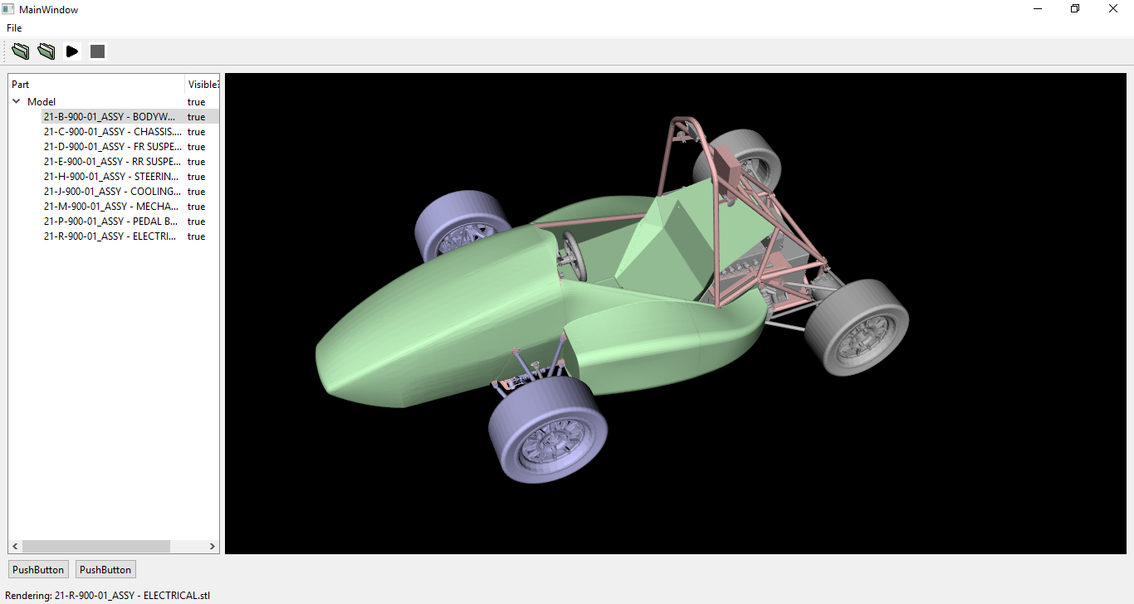
Limits on number of actors
Car model can be broken down into parts
Each part has its own actor
Each actor can be independently
Coloured
Filtered
Manipulated
Moved in code
Moved with VR controller
Each actor adds computational overhead
More parts/actors, more interactive
Too many – won’t render smoothly!

Slide 20

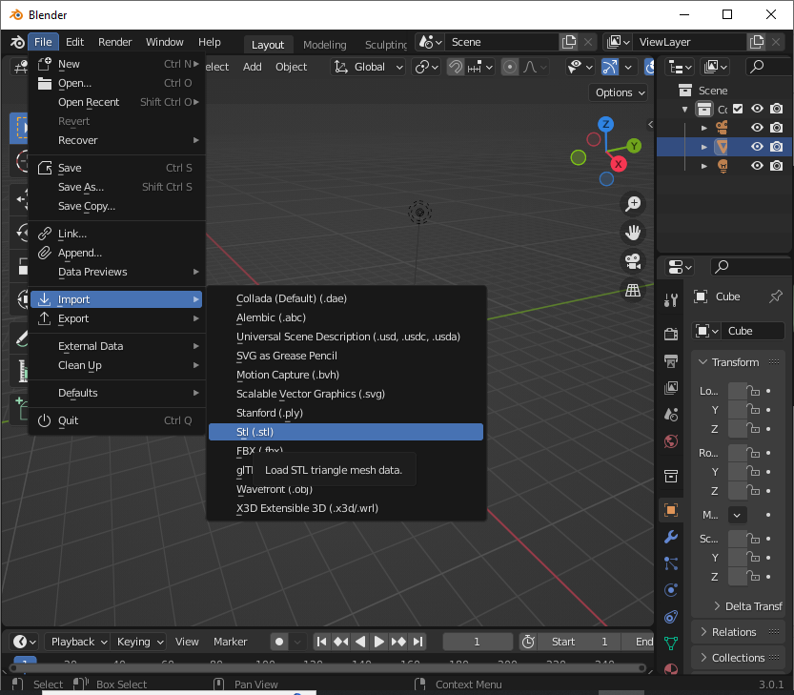
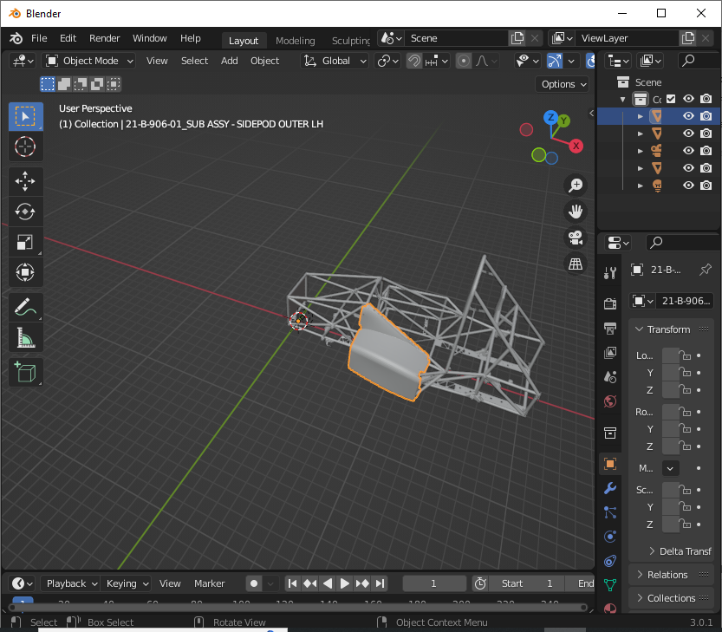
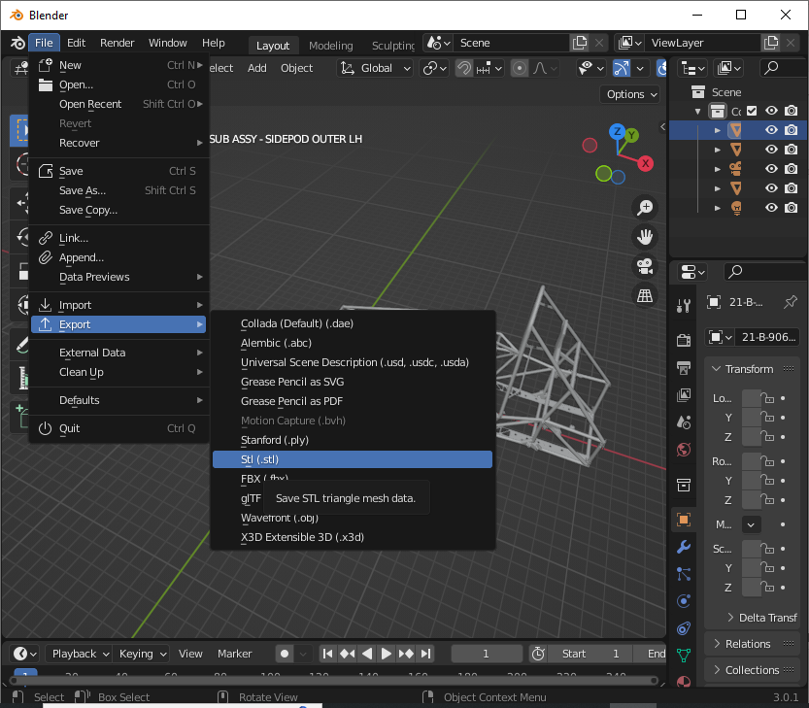
Download Blender: https://www.blender.org/
Import sub components from full list
View assembled sub-components
Export as new STL sub-assembly

Slide 21
Lighting
Light
Data Source
Mapper
Filters
Actor
Data Source
Mapper
Filters
Actor
Renderer
RenderWindow
Data Source
Mapper
Filters
Actor
Data Source
Mapper
Filters
Actor
Light classes added to renderer.
Each light class defines a light source / type
Can add multiple lights

Slide 22


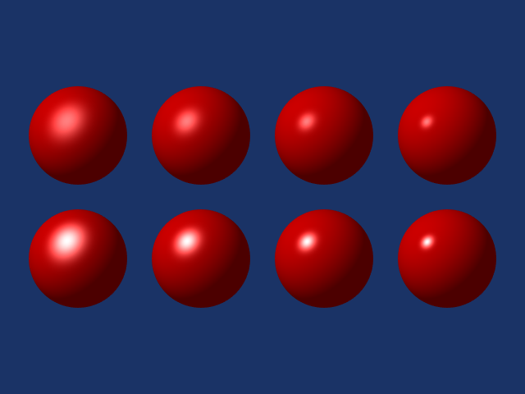
vtkLight class
Use the VTK Light Class
Lights can have colour – different for ambient, diffuse, specular
Lights can have position
Lights can be directional (e.g. a spotlight emits light in limited direction)
Lights are added to vtkRenderer:
renderer->AddLight( light );
A list of lights in the renderer can be retrieved using:
vtkLightCollection *lights = renderer->GetLights();
The vtkLightCollection is a list that can be iterated through
E.g., to change brightness of all lights
Surface properties (how surfaces react/reflect different types of light) can also be set
See documentation and examples:
https://vtk.org/doc/nightly/html/classvtkLight.html
https://vtk.org/doc/nightly/html/classvtkRenderer.html
For VR: Need to make sure light position doesn’t move with user, or model if model is rotating.
Light position fixed to room position.
https://kitware.github.io/vtk-examples/site/Cxx/Rendering/AmbientSpheres/
https://kitware.github.io/vtk-examples/site/Cxx/Rendering/DiffuseSpheres/
https://kitware.github.io/vtk-examples/site/Cxx/Rendering/SpecularSpheres/

Slide 23
Adding VR to your GUI and use of threads

Slide 24
VR Renderer
Data Source
Mapper
Filters
Actor
Renderer
RenderWindow
Mapper
Filters
Actor
VRRenderer
VRRenderWindow
Data Source
Mapper
Filters
Actor
Mapper
Filters
Actor
Need to add an additional renderer for VR
Complication: One mapper/actor can only be added to one renderer, need to create new classes for each object/renderer

Slide 25
Threads
main() {
MainWindow w;
w.show()
}
By default, your program has one thread:
Execution is transferred from main() to the Qt MainWindow
MainWindow then retains control of the program
Calls functions such as buttonclicked() but expects this function to return quickly
When the VR runs, VTK wants to take control of the main thread
The VR process is effectively an infinite loop
If you implement a standard “runVR()” slot function, it will not quickly return to MainWindow
Qt no longer has control of program
It cannot handle further button clicks
The UI becomes unresponsive
MainWindow class
button1Clicked()
button2Clicked()
runVR()

Slide 26

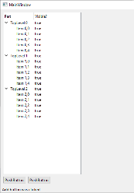
Required Structure
Use a special render thread class. This class is able to run its own functions independently of the MainWindow.
Allows RunVR() to return instantly and for MainWindow to continue to handle VR
MainWindow class
VRRenderThread class
TreeView
run()
Contains an infinite loop that handles VR
runVR()
Data Source1
rotateVRItem()
rotateItem()
Data Source2
Main difficulty is keeping VR thread and VR renderer up to date with GUI – the run function is executing in parallel and controls the VR renderer, need to ask it to make changes such as a rotation
Data Source3
VTKRenderer
VTKVRRenderer
Need to consider how duplicate mapper/actors are created and passed to VR thread
Further complicated in case of filters

Slide 27
DLLs and Installers

Slide 28
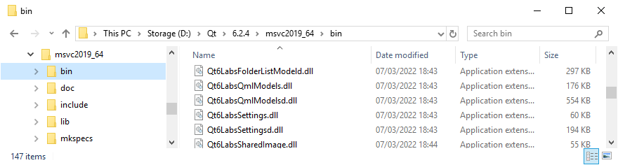
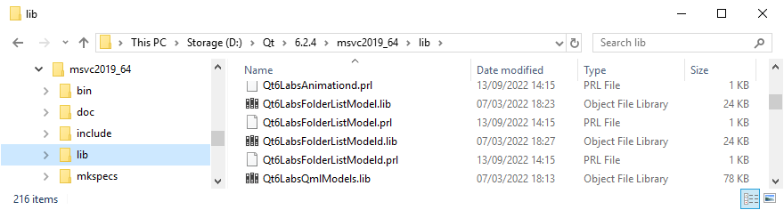
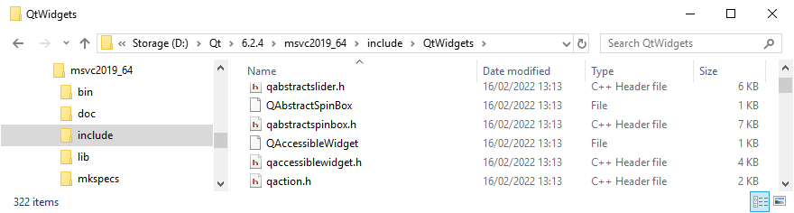
General Library Structure – Qt and VTK
bin sub-directory – binaries, e.g. .dlls
lib sub-directory – libraries, e.g. .libs
include sub-directory – libraries, e.g. .h
Your code needs headers that to tell the compiler which functions are in the library. E.g: stdio.h contains definition of printf()

Slide 29


Dynamic Linking
Headers
Import Tables
DLL is basically an executable that doesn’t have a main() function
It wants to export functions rather than import them
Windows – DLLs can end up installed anywhere, they must be on the path otherwise they won’t be found
Only one copy of DLL needs to exist: both on hard-drive and in RAM
Dynamic linking handled by Windows using Import/Export Address Tables
Export Tables
msvcrt.lib
msvcrt.dll
Headers
main.obj
Import Tables
Export Tables
Linker
read.obj
main.obj
Executable contains code for all functions, including library, and some header information
read.obj

Slide 30
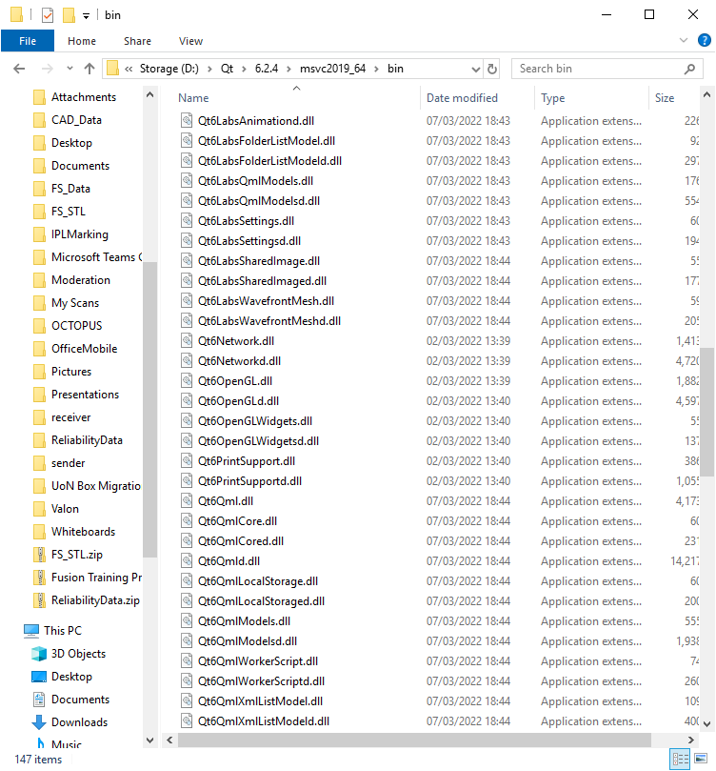
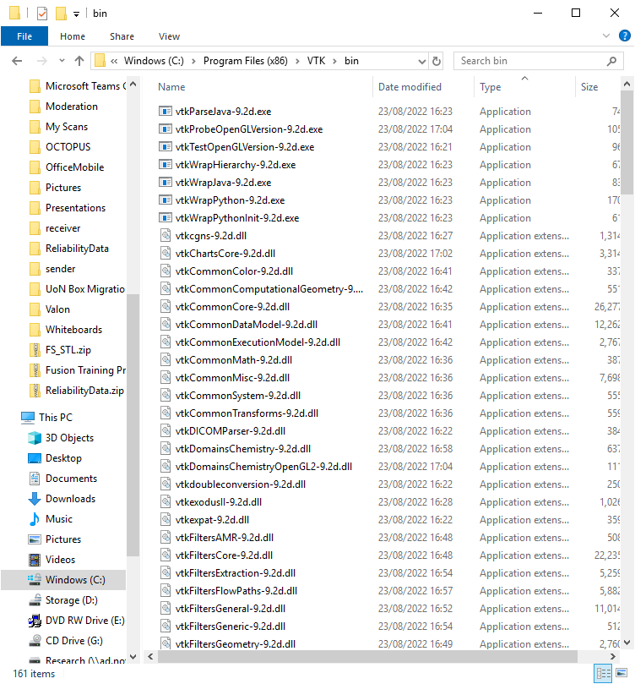
Dynamic Libraries for Qt and VTK
Aim: Installer that can be run once, on any compatible Windows PC, your program then works perfectly
Problem: Qt and VTK enabled applications need to find correct version of Qt/VTK DLLs when they run
Either on path, or in same folder as executable
With Windows, cannot assume end user has installed correct version of Qt/VTK
Installer needs to copy across correct DLLs
If you copy all DLLs for both Qt and VTK, installer will be massive
Can manually determine which DLLs used, add a “target” to the CMakeLists that includes these in installer
Can use tool such as dependencies for this: https://github.com/lucasg/Dependencies
Utility for Qt that finds required DLLs automatically:
QtWinDeploy: https://doc.qt.io/qt-6/windows-deployment.html

Slide 31
Group Work – Tasks

Slide 32
Overall Aim: VR Application with interactive FS Car
Assessment 1a: Group Repository – Source code
Code
Does it compile?
Does it compile first time, with Cmake, no problems?
Is the code formatted properly, do classes and variables have sensible names, do files have sensible names?
Does the program run from Visual Studio without crashing?
Documentation (Comments & Online)
Code documentation with Doxygen: do the comments exist, are they consistently applied, are they useful
All classes, variables, functions are properly commented
Additional comments explaining more advanced parts of code
Github.io website with auto-generated documentation
Git
Git: Repository structure, Readmes, regular commits from all group members, individual contributions managed appropriately (branches or forks, etc), .gitignore and binaries, installer available as release.
Installer
Can be generated using Cmake
Automatically includes all necessary libraries so that final application runs “standalone”
Have you implemented required features, does the code compile and run?
Have you used tools described in worksheets properly?

Slide 33
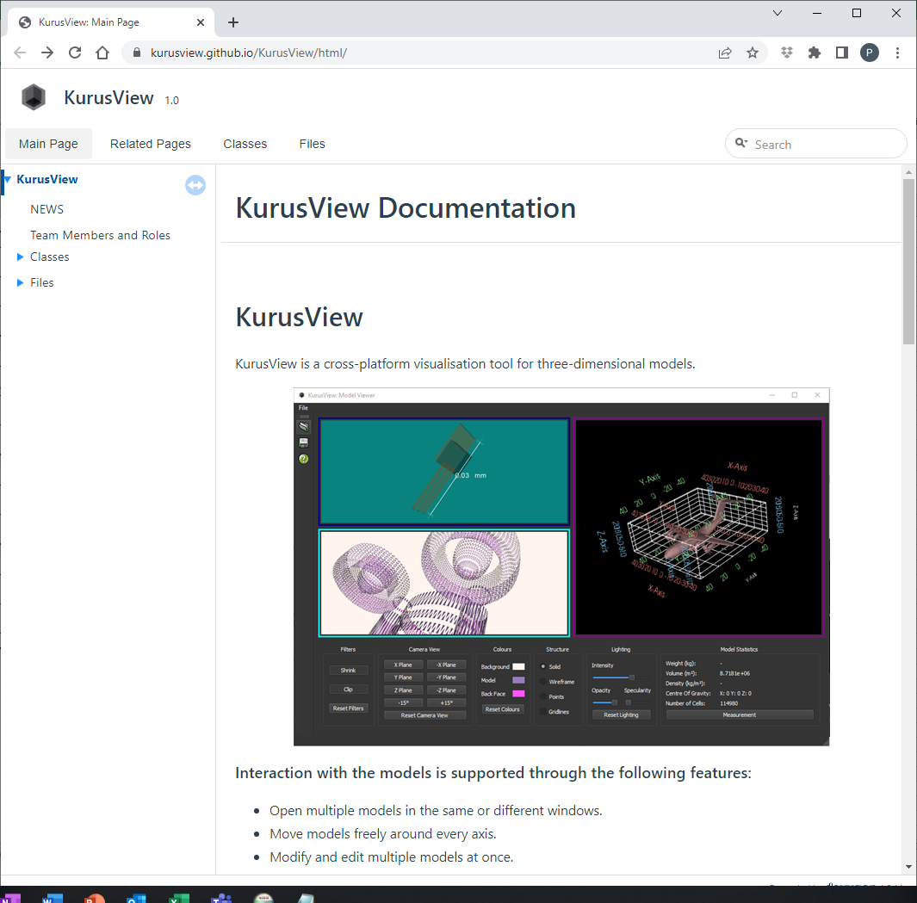
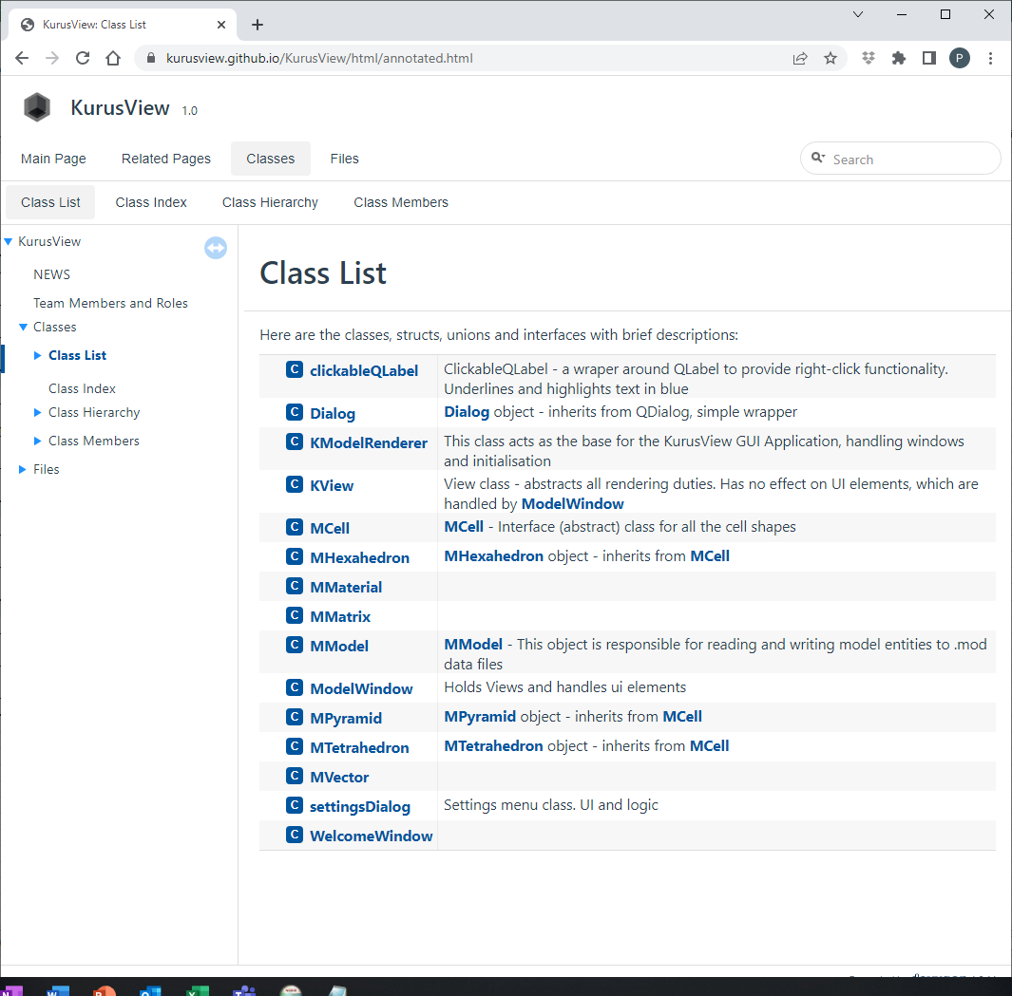
Documentation Website
https://kurusview.github.io/KurusView/html/index.html

Slide 34
Overall Aim: VR Application with interactive FS Car
Assessment 1s: Group Repository – Installer
Installer
Installer uploaded to Moodle
Proper Windows style installer
Runs on my computer, with all necessary libraries included
Uninstaller works
Application
All Qt content tested – treeview, file loading, filters. VR content is not assessed – this is covered in demo
See marksheet for all criteria
Stability tested - can I make it crash?
Have you implemented required features, does the code compile and run?
Have you used tools described in worksheets properly?

Slide 35
Overall Aim: VR Application with interactive FS Car
Assessment 2: Demonstration
Installer
You can download, install, run your program on PC without Qt/VTK/OpenVR/examples installed.
Icons and shortcuts: Start menu links, desktop shortcut, shortcut for uninstaller
Uninstaller that works
Basic Functionality
User interface looks good, is functional
You can start the VR
You can make changes in the GUI and these are reflected in the VR
You can stop the VR
VR Features (60%)
VTK Filters work on car parts
Can change properties of parts, add/remove parts, change filter status ‘live’
Virtual Environment
Animation
Efficient / effective implementation
Own ideas
How well does the final application work?
Quality of features added
70%
The marks in this section will add up to more that 100%. If you do something interesting that isn’t suggested then this will compensate for other features you didn’t get working.
50%

Slide 36
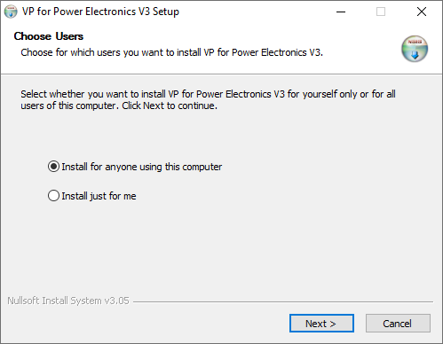
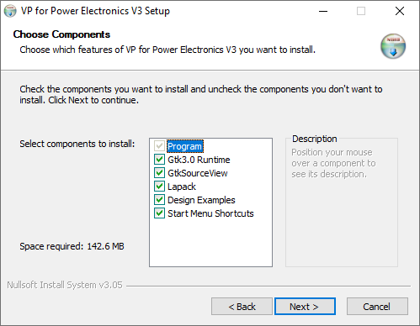
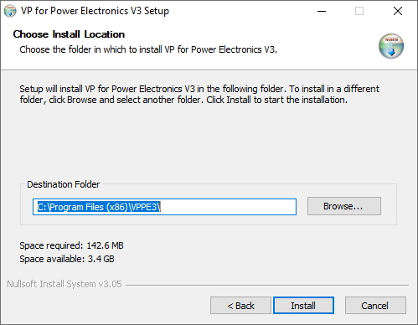
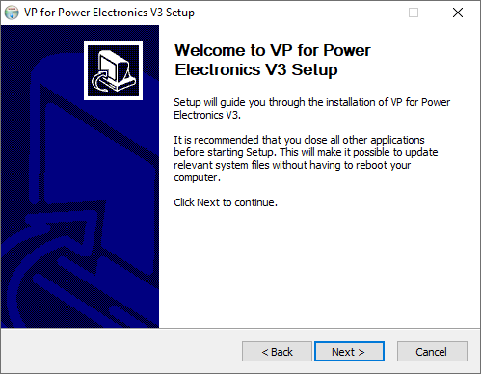
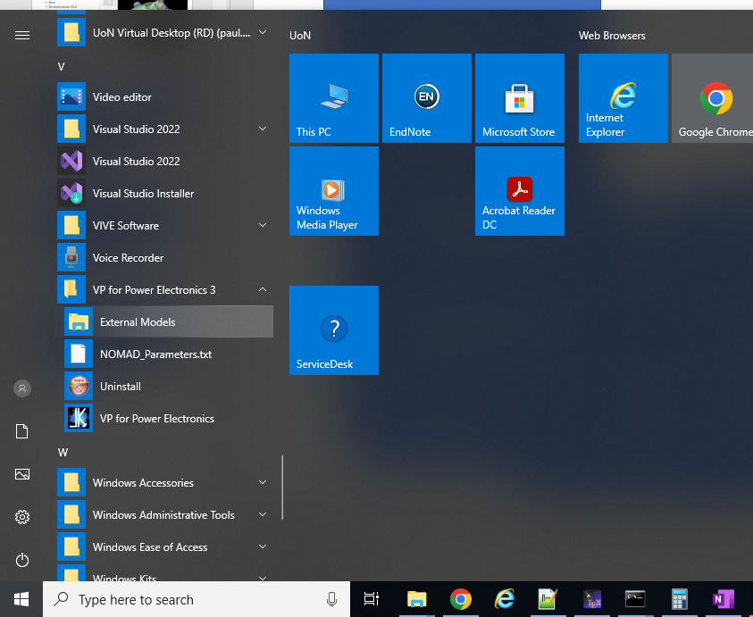
Demonstration – Installer
Typical “Good” installer interface
Functional
It works!
Appearance
Behaves like typical Windows installer
Standalone
Option for all libraries / DLLs to be installed!
It just works after installation
Start Menu
Folder with relevant links
Uninstaller
Works – leaves no trace!
Auxiliary Files
Documentation, CAD models (in Documents Folder)
You will be asked to demonstrate all of this

Slide 37
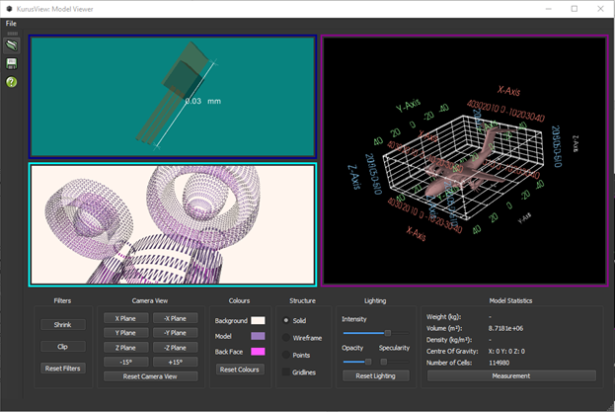
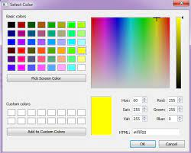
Demonstration – GUI
Widgets
Attractive and Appropriate
Overall layout scales to different window size
e.g. ColorPicker rather than R,G,B numbers
Toolbars, icons, menubars
Lack of bugs
Should be able to use any combination of settings / button clicks without it crashing or doing something unexpected
Getting this to work is harder than you think!
Live Model Editing
Make changes to visualisation settings in GUI
These are reflected in VR
VR Start / Stop
VR can be started / stopped / restarted?
Without crashing?

Slide 38
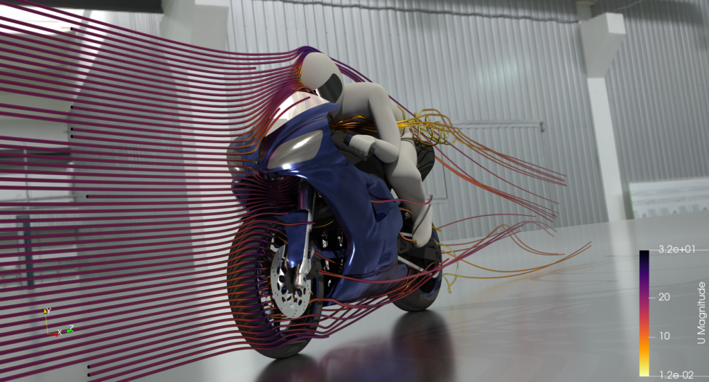
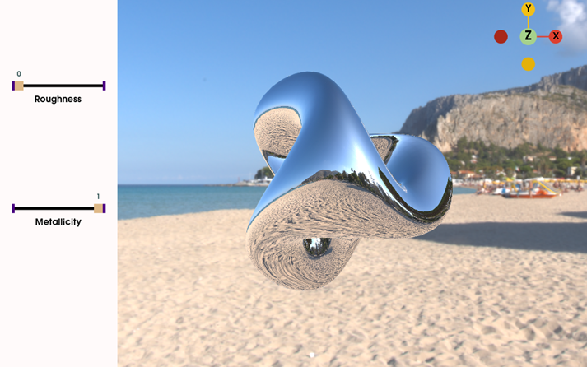
Demonstration – VR Features
Own Ideas
As title suggests!
One concept already put forward is to overlay “simulation” data – e.g. airflow over car
This could be made up data, could come from an actual simulation (if you want to look at CFD – see OpenFOAM)
Filters
Mechanism for enabling filters on model components
2x filters, any combination, any component
Seamlessly
Virtual Environment
Example model just floats
A floor (that corresponds to real floor position) would help
Walls/scenery (vtkSkyBox)
Model Editing from GUI
Menus / dialogs, etc to enable/disable all these features from GUI
Any combination, no crashing!
Animating Model
Set model to rotate, etc
Perhaps explode (parts move away from each other into distance?
See what you can do
https://www.openfoam.com/
https://examples.vtk.org/site/Cxx/Rendering/PBR_Skybox/

Slide 39
Viva
Assessment 2: Demonstration
Technical questions across 4 topics:
C++ and OOP
Git
Building software: Compilers, libraries, Visual Studio, Cmake
Qt & VTK
Your contribution to group:
Explain what you contributed
Ability to explain how/why you implemented your features the way you did
Technical understanding of what you did.
How well does the final application work?
Quality of features added

Slide 40
Final Points

Slide 41
Time Management
Start the group work as soon as you can!
You should have the beginnings of the group work before the end of the next project week:
A working GUI code base in the group repository
All group members understand what you are aiming for
All group members understand what they are responsible for implementing
Use the output from individual worksheets as the starting point.

Slide 42
Group Work
You need to attend the lab sessions, every day.
It causes problems for the group if you don’t.
You can’t get support if you aren’t there.
You should ideally start the group work together (i.e. finish the worksheets at about the same time)
If this isn’t the case (very wide range of abilities), let me know.
Need to plan the group work so that everyone can contribute
Need to avoid the strongest group member doing all the obvious/easy things.

